Slide 1
Modelsim Tutorial

Slide 2
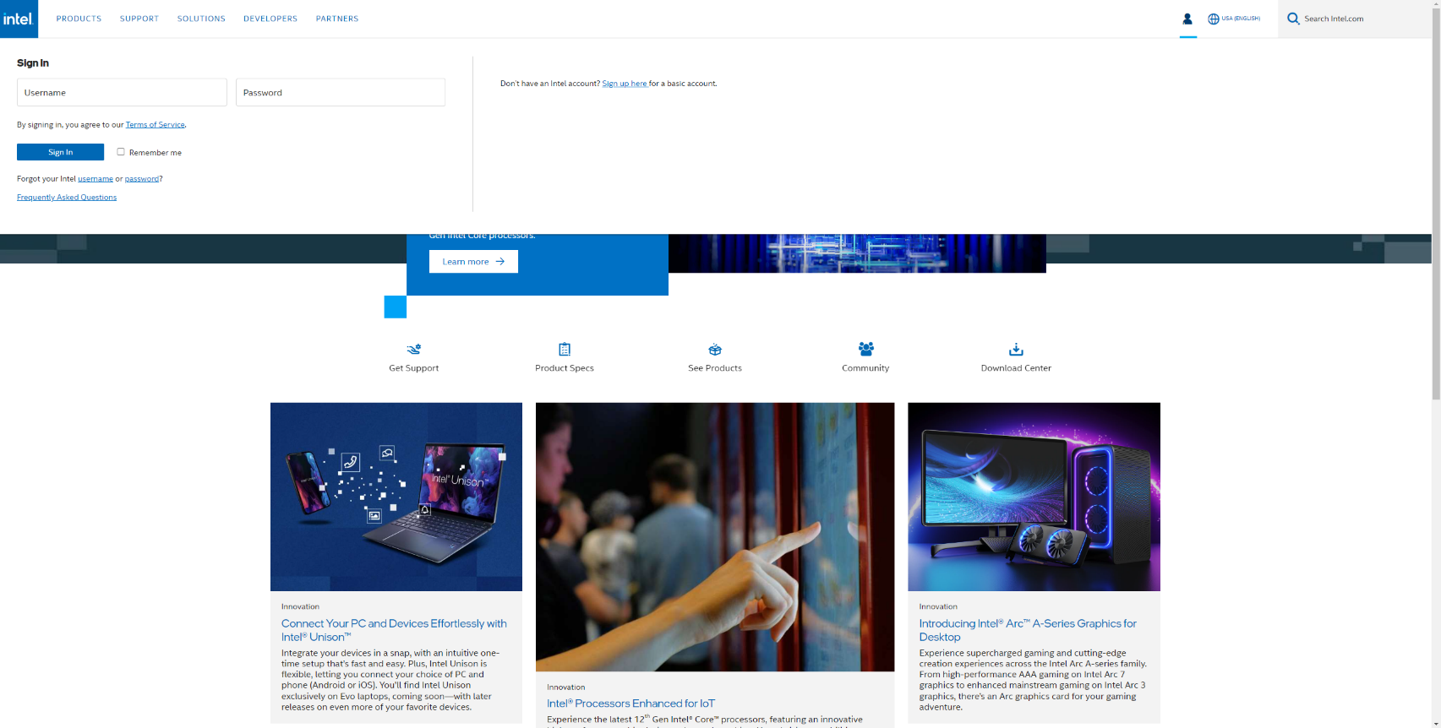
Installing Modelsim
Intel Homepage
https://www.intel.com/content/www/us/en/homepage.html
Click 1
Click 2

Slide 3
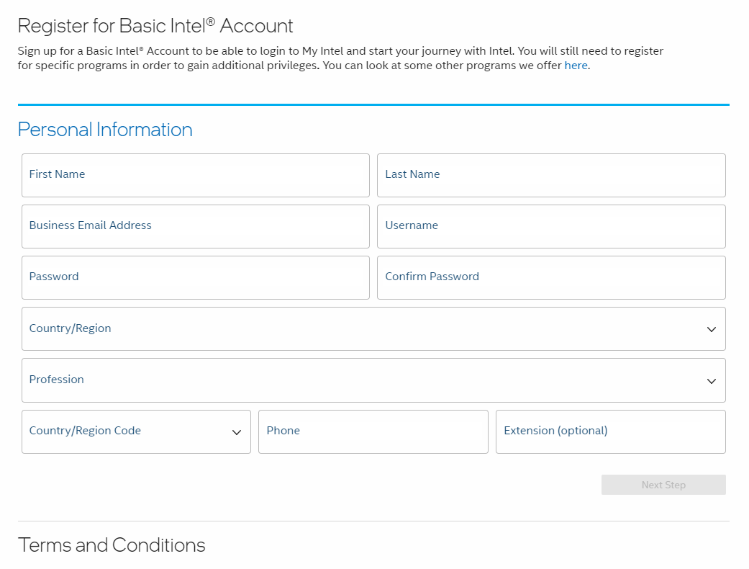
Installing Modelsim
Sign up

Slide 4
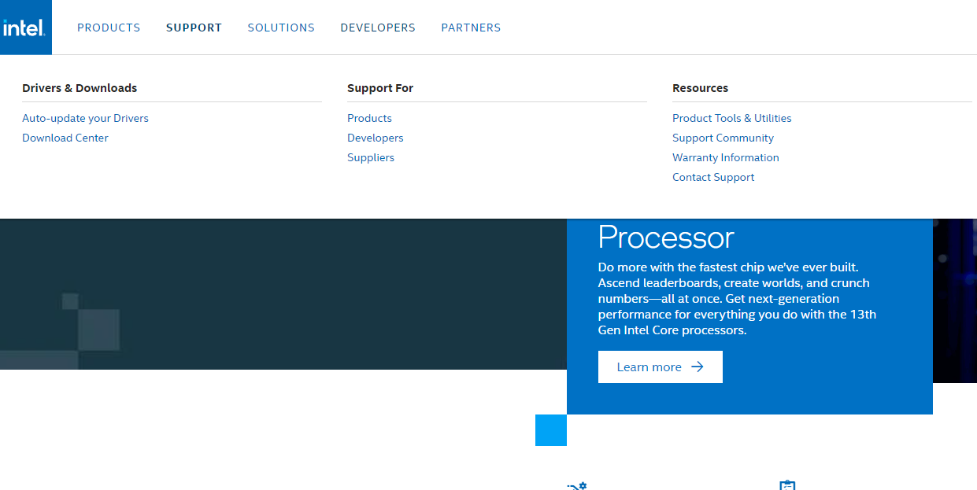
Installing Modelsim
Login and Click Support - Download Center
Click
Click

Slide 5
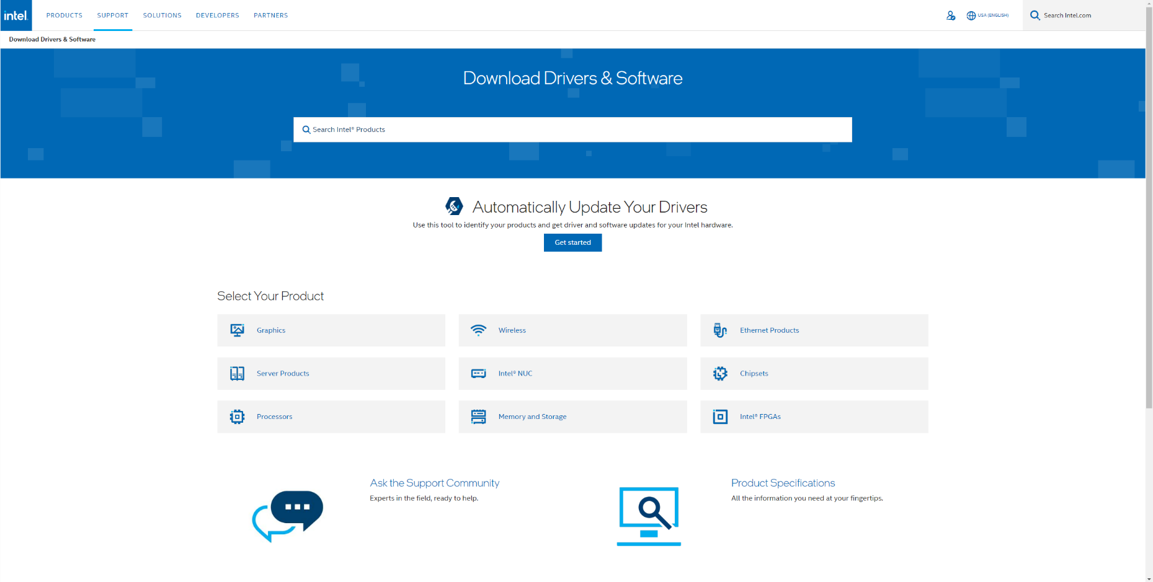
Installing Modelsim
Click Intel FPGAs
Click

Slide 6
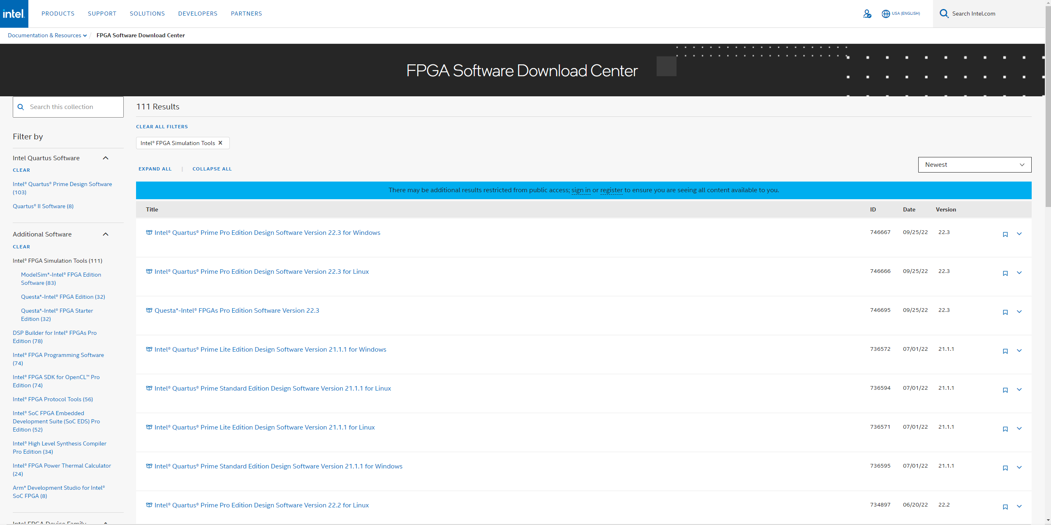
Installing Modelsim
Click Modelsim-Intel FPGA Edition Software
Click

Slide 7
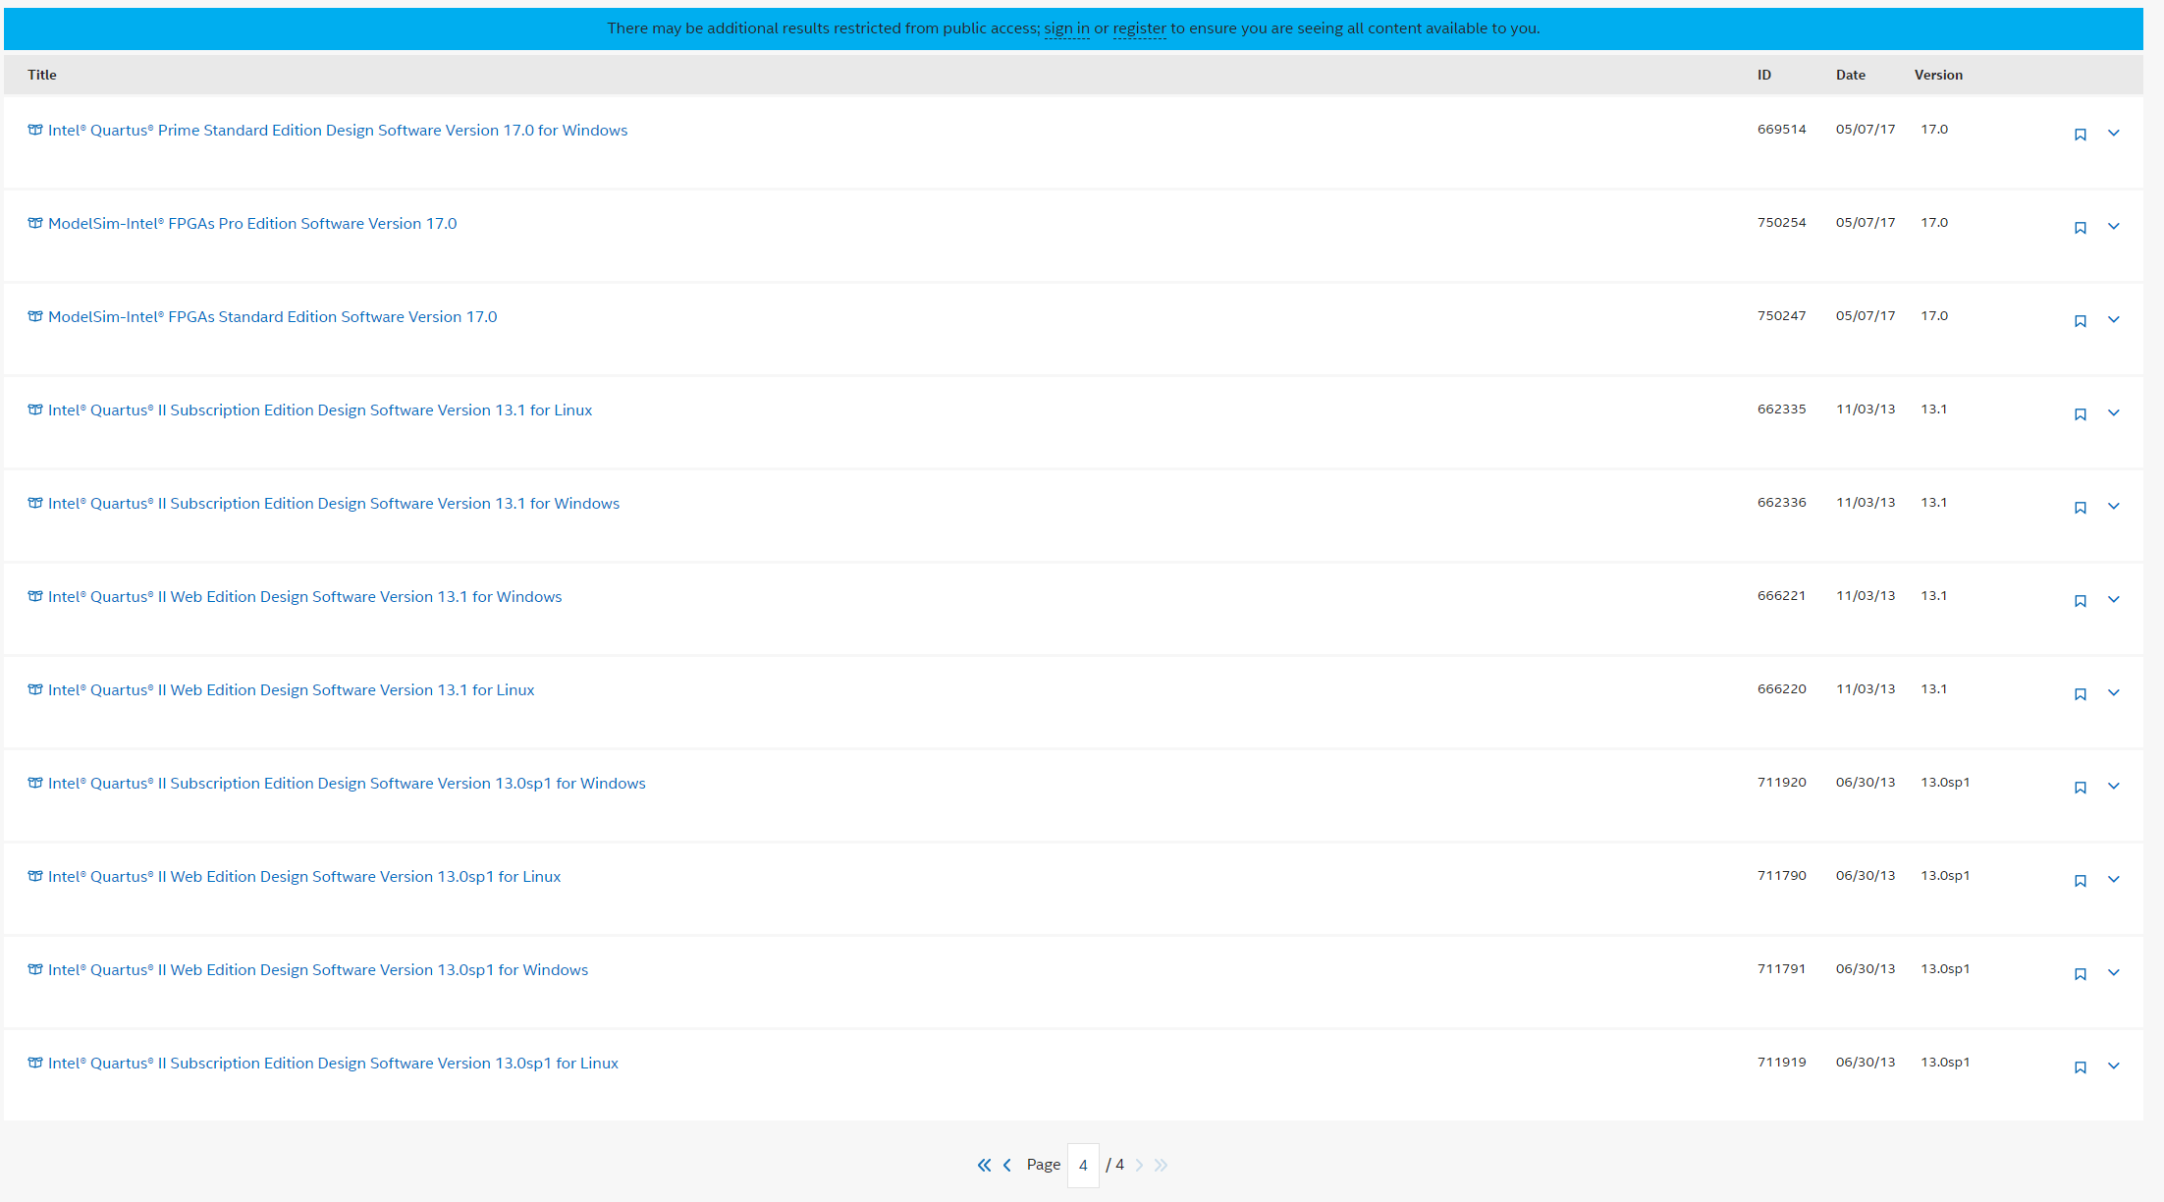
Installing Modelsim
Click Modelsim-Intel FPGAs Standard Edition Software Version 17.0
Click

Slide 8
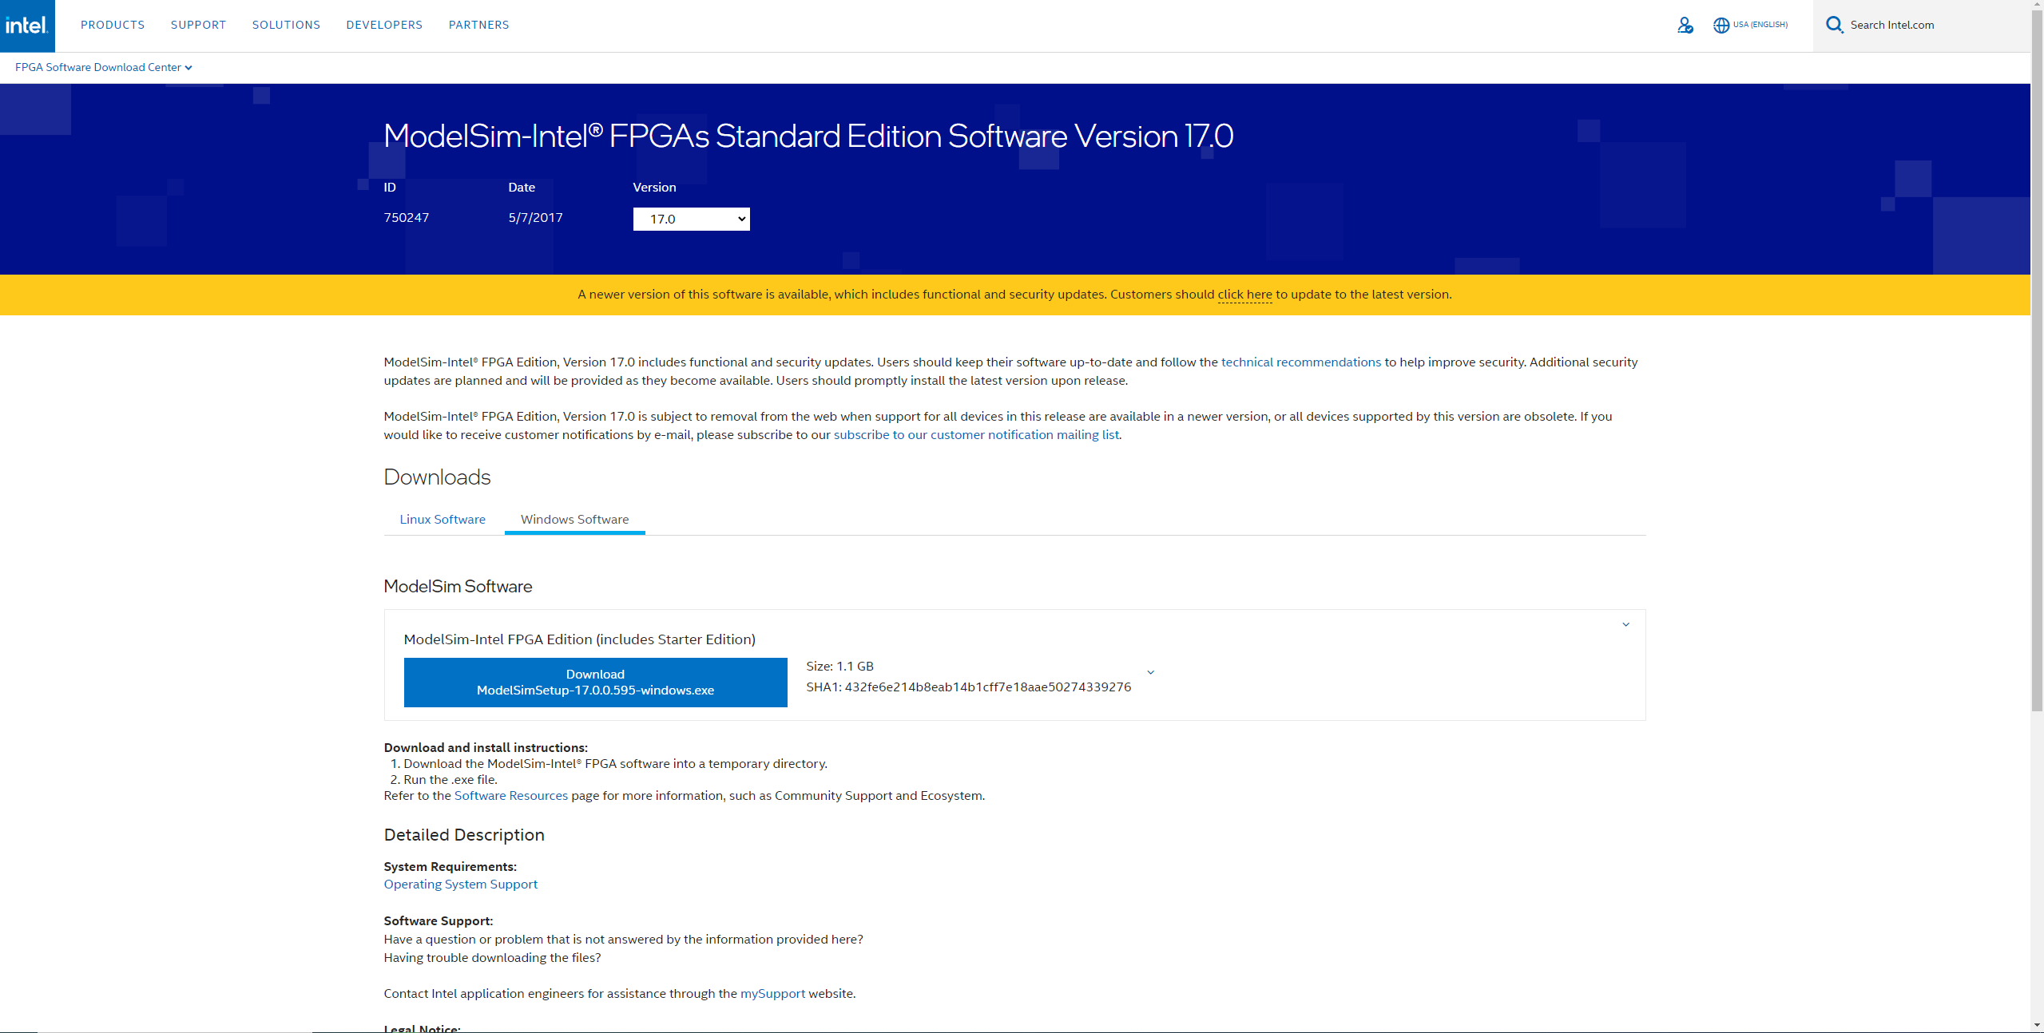
Installing Modelsim
Download ModelsimSetup according to your OS
Click

Slide 9
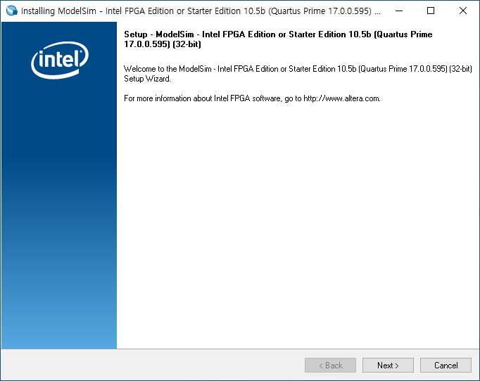
Installing Modelsim
Click

Slide 10
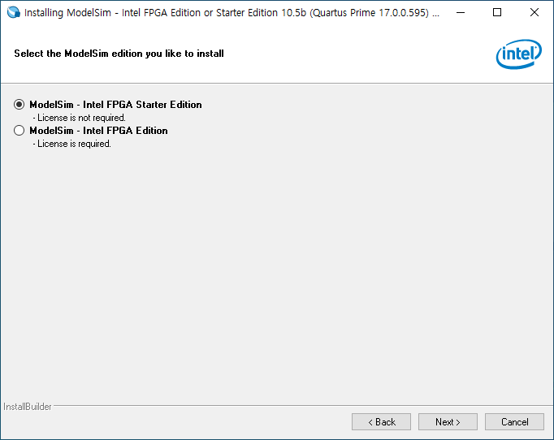
Installing Modelsim
Click

Slide 11
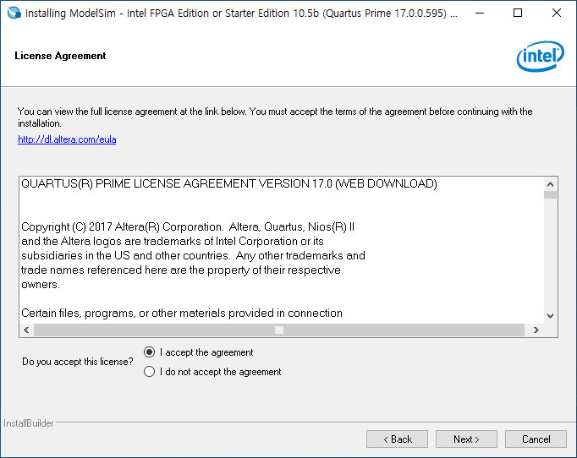
Installing Modelsim
Click

Slide 12
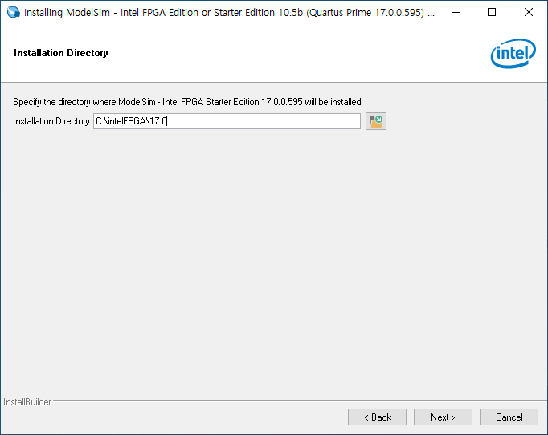
Installing Modelsim
Korean should not be included in the Directory path.

Slide 13
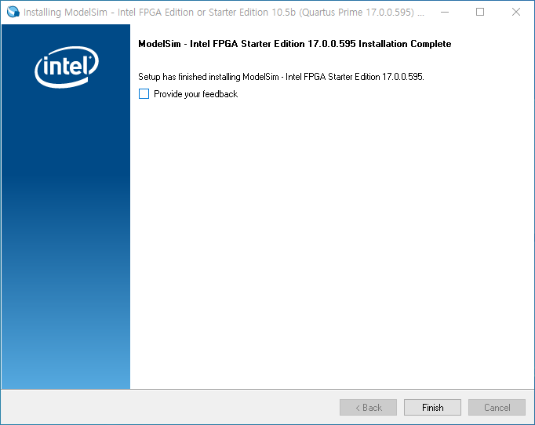
Installing Modelsim
Installation is done

Slide 14
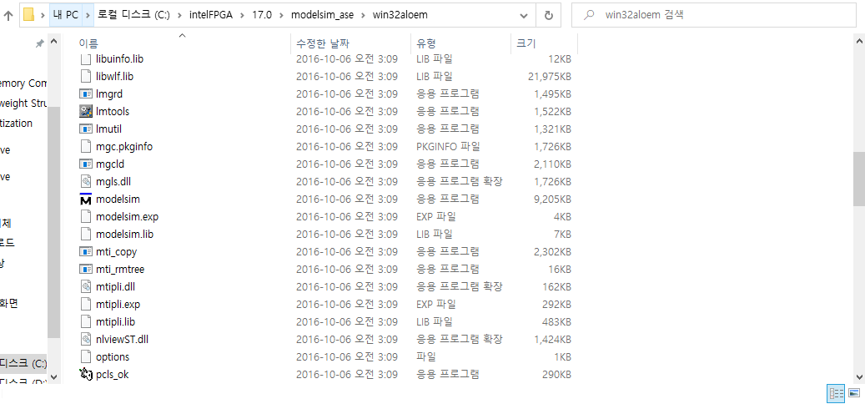
Open Modelsim
Directory Path: C:\intelFPGA\17.0\modelsim_ase\win32aloem
Click

Slide 15
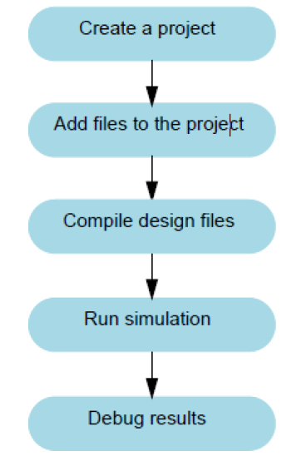
How to Use Modelsim
Project Flow
More Information: ModelSim Tutorial (microsemi.com)

Slide 16
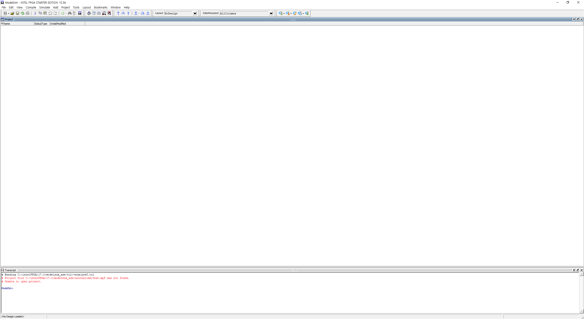
How to Use Modelsim
Basic Screen
Menu Bar
Work Window (Project, Code editor, simulator, etc.)
Log / Command Window

Slide 17
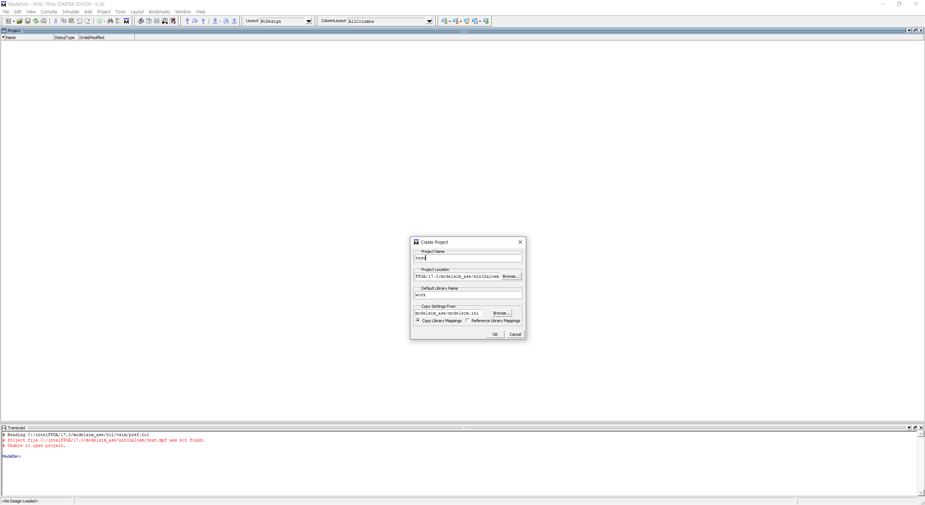
How to Use Modelsim
Create Project
File – New - Project

Slide 18
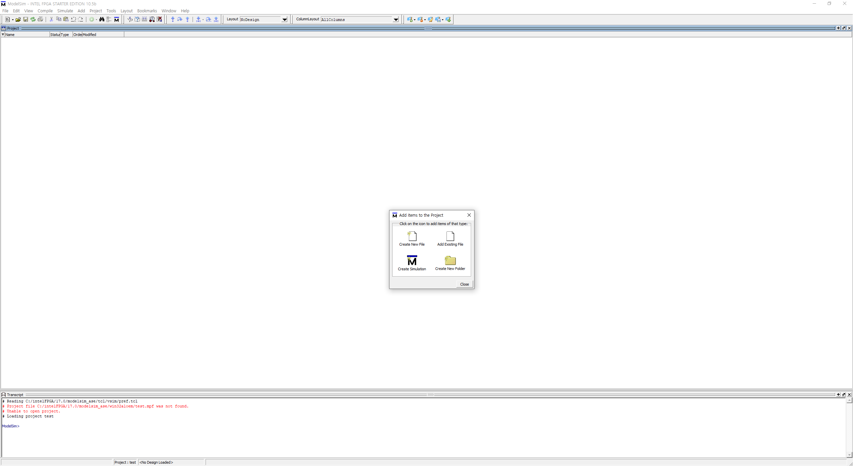
How to Use Modelsim
Create v File (Source File)
Create New File: Create new v file in project
Add Existing File: Add the existing v file to project

Slide 19
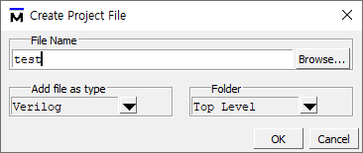
How to Use Modelsim
Create v File (Source File)
Name your source file (you can use only English and ‘_’)
2. Set the Verilog

Slide 20
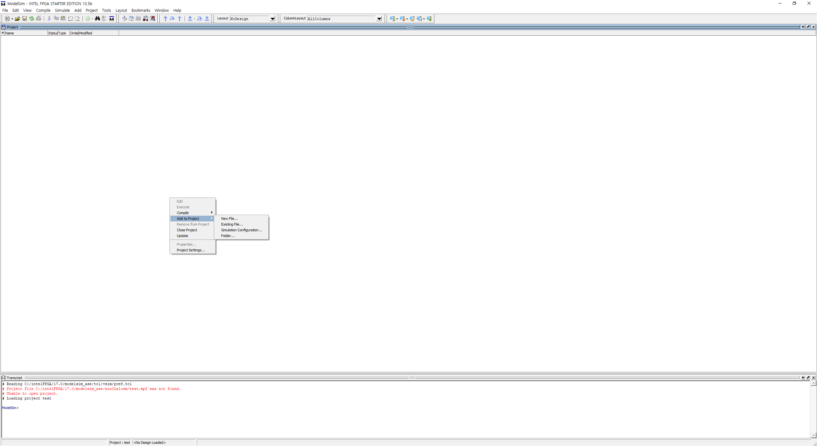
How to Use Modelsim
Create v File (Source File)
The above process can also be created by right-clicking on the project screen.

Slide 21
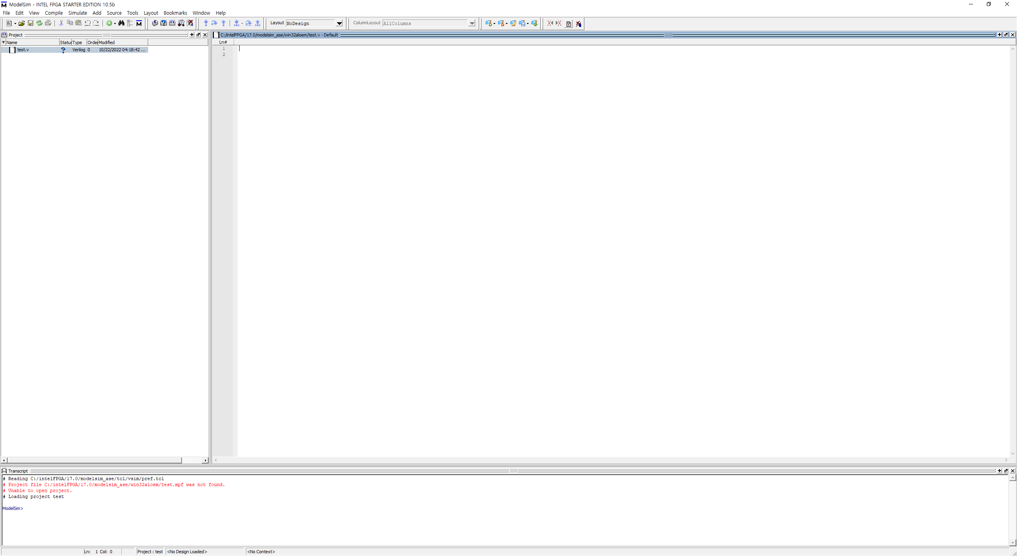
How to Use Modelsim
Editor Screen
Double click ‘test.v’

Slide 22
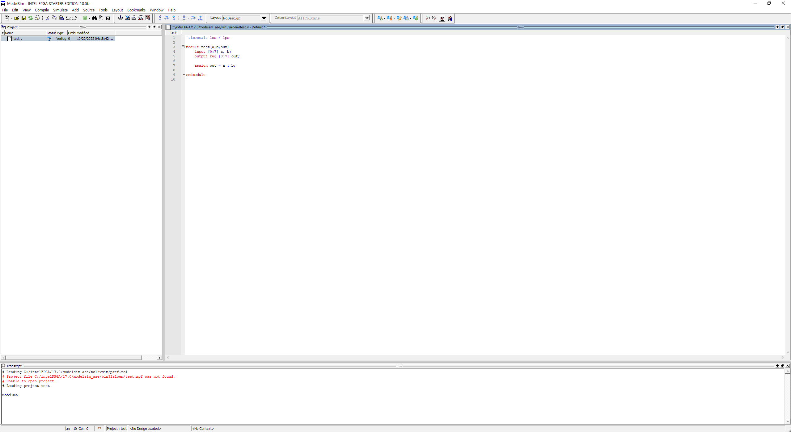
How to Use Modelsim
Example) 8-bit AND gate

Slide 23
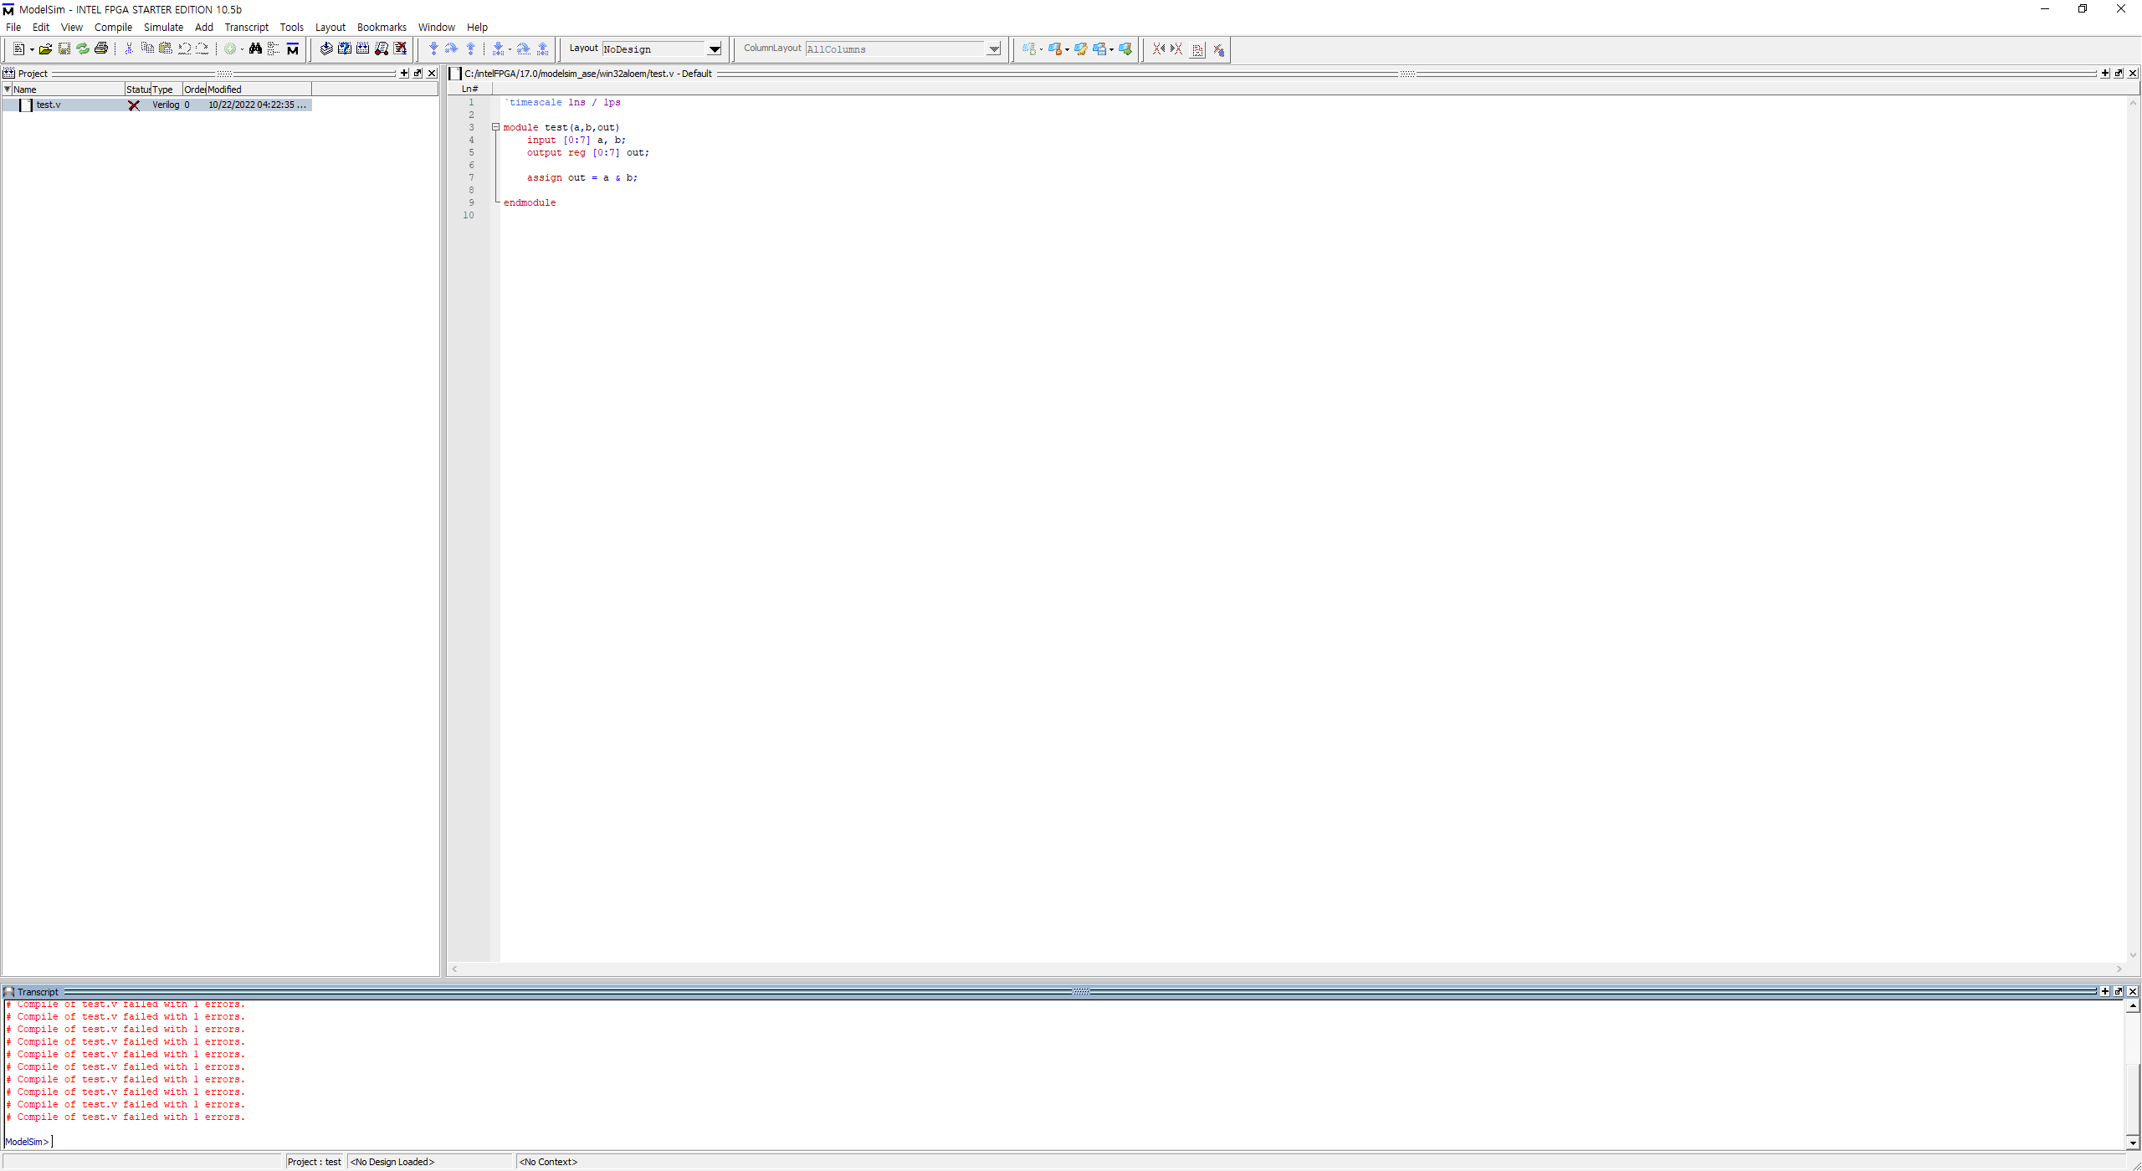

How to Use Modelsim
Example) 8-bit AND gate
Compile
Simulate compiled module
Double click error

Slide 24
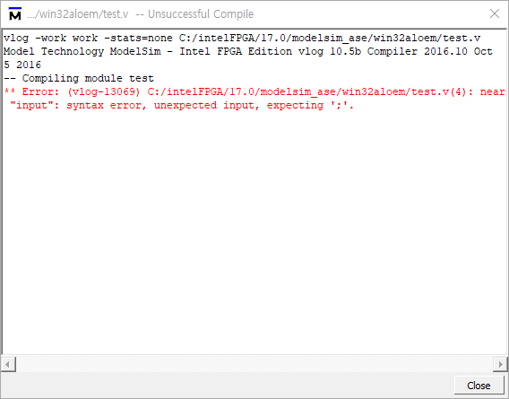
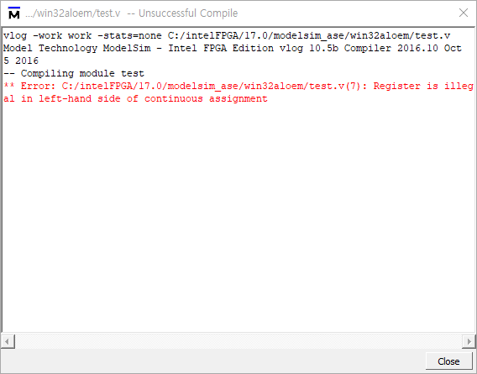
How to Use Modelsim
Error Report
module test(a, b, out) -> module test(a, b, out);
output reg -> output

Slide 25
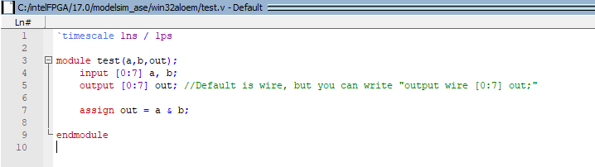
How to Use Modelsim
1. Error Correction
2. Ctrl + s or save
3. Compile

Slide 26
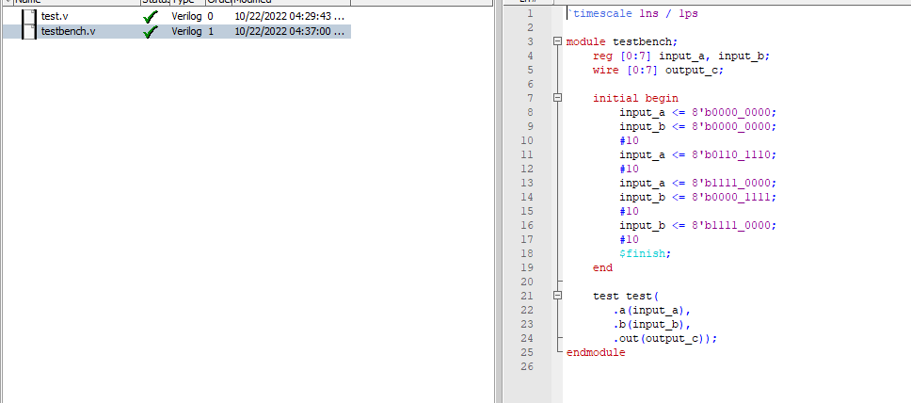
How to Use Modelsim
Create ‘testbench.v’ file (in the same project)
Save file and compile

Slide 27
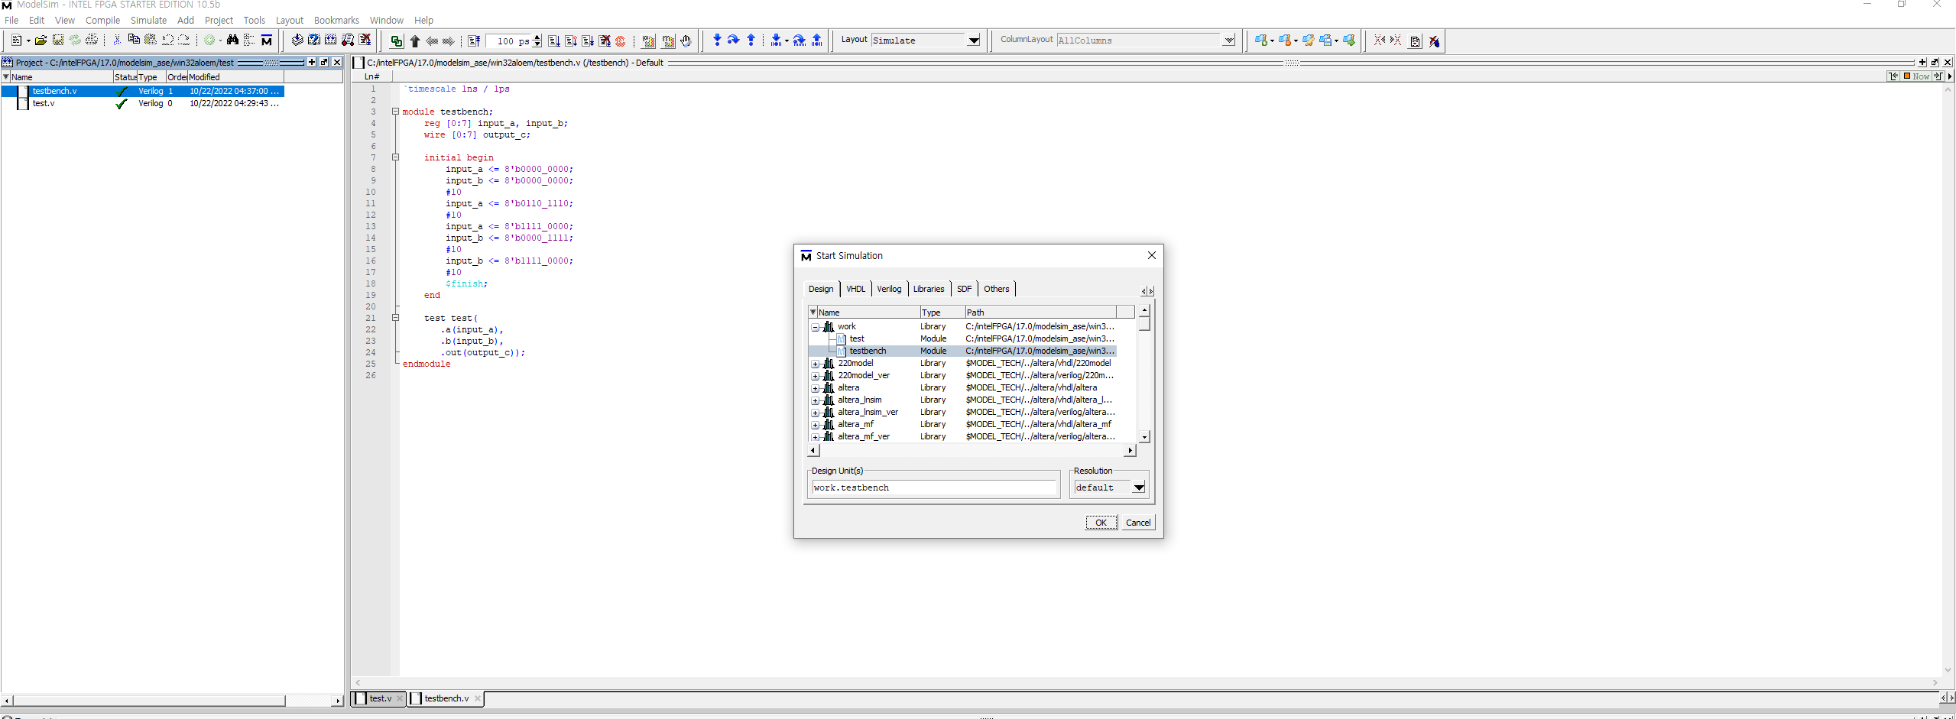
How to Use Modelsim
Simulate testbench
Simulate compiled module
Click testbench file
Click ‘OK’

Slide 28
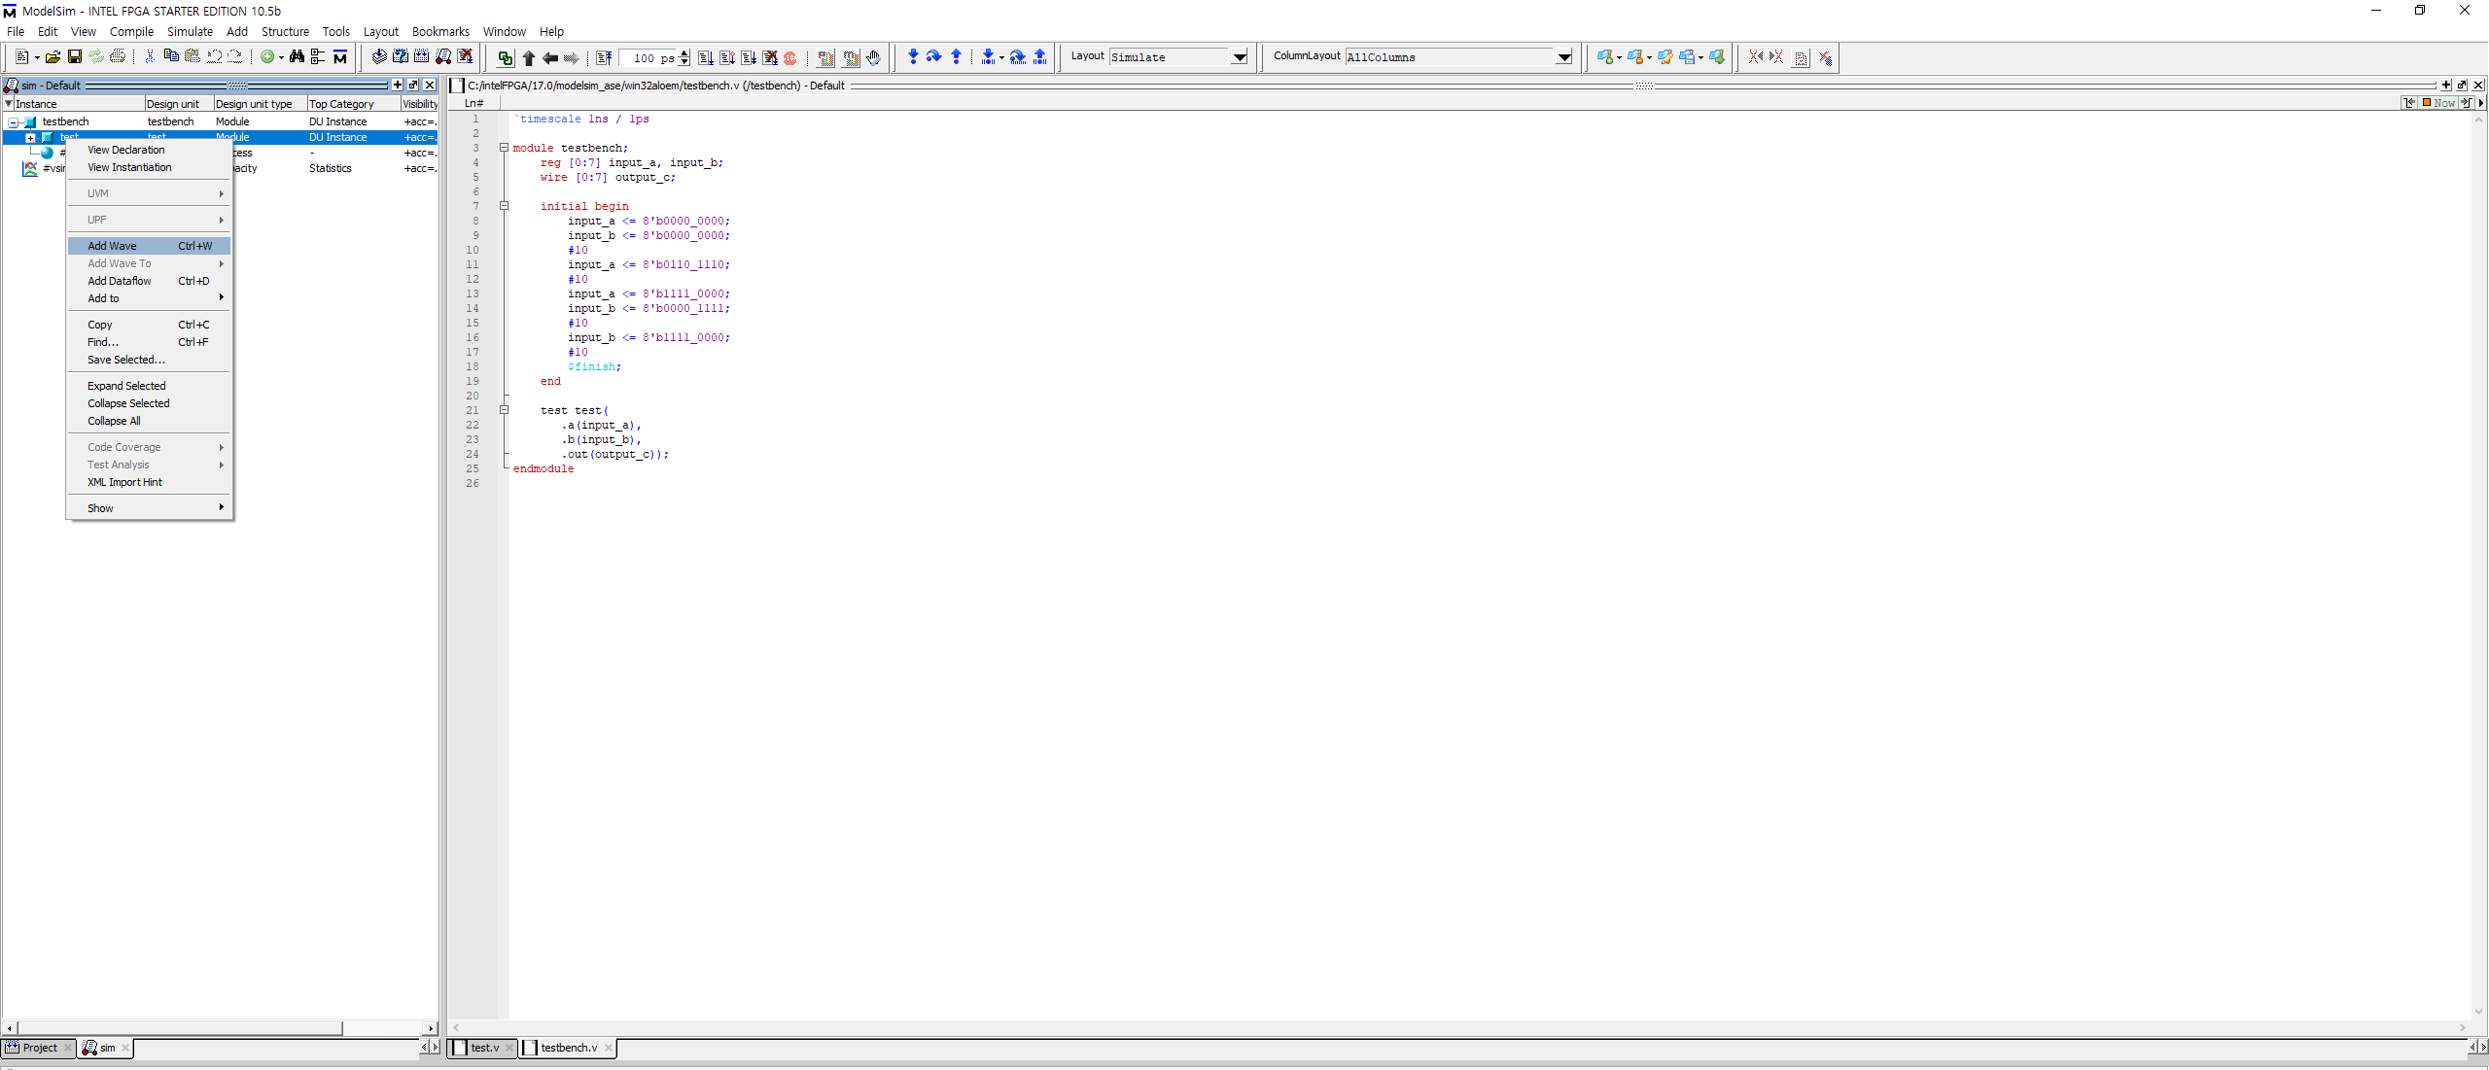
How to Use Modelsim
sim – Default Screen
Right-click the top module and click Add Wave in the menu
(Topmodule is test.v file in this example)

Slide 29
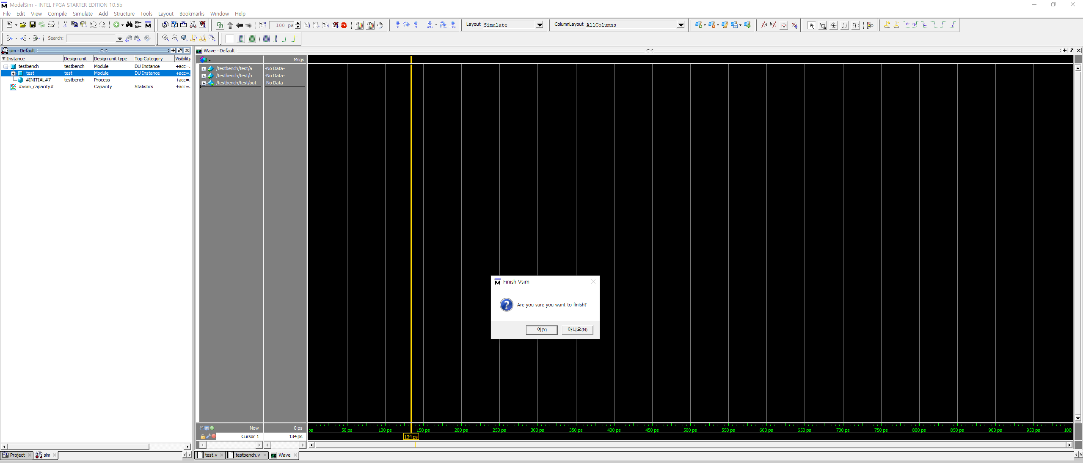
How to Use Modelsim
Waveform Simulation
1. Click Run-All
2. Click ‘No’
3. Click ‘Wave’

Slide 30
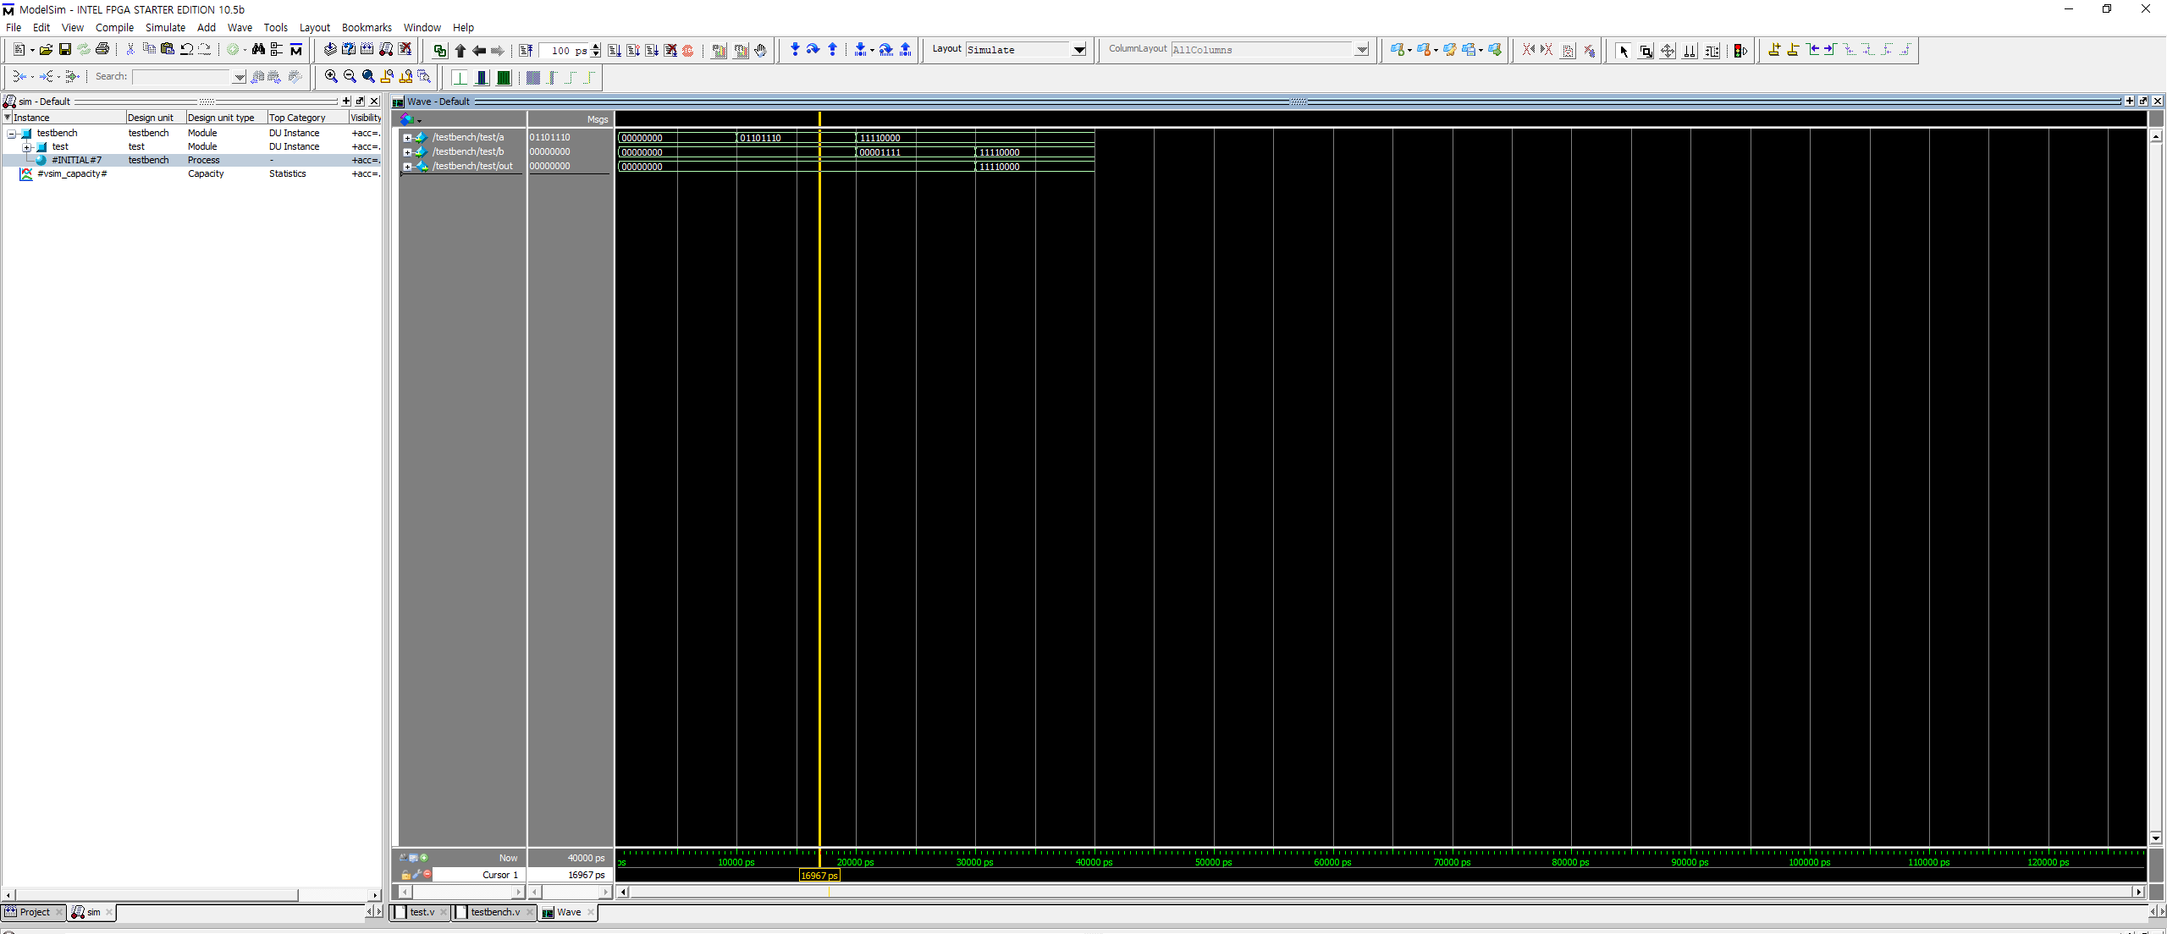
How to Use Modelsim
Check the waveform simulation result
Zoom in/out

